Slide 1

Diabetes Prediction Using Machine Learning Algorithms
Under the esteemed guidance of
Dr . D. Suneetha
Professor & Head of the Department
Presented by:
19KN1A05H2 – S. Harish
19KN1A05E4 - P. Rakesh
19KN1A05I1 - V. Bhargav
NRI INSTITUTE OF TECHNOLOGY
(Accredited by NBA:CSE,ECE,EEE)
An Autonomous institution,Premanently Affiliated to JNTUK,Kakinada
(Accredicted by NAAC with ‘A’ Grade and ISO 9001:2015 cretified Institution)

Slide 2
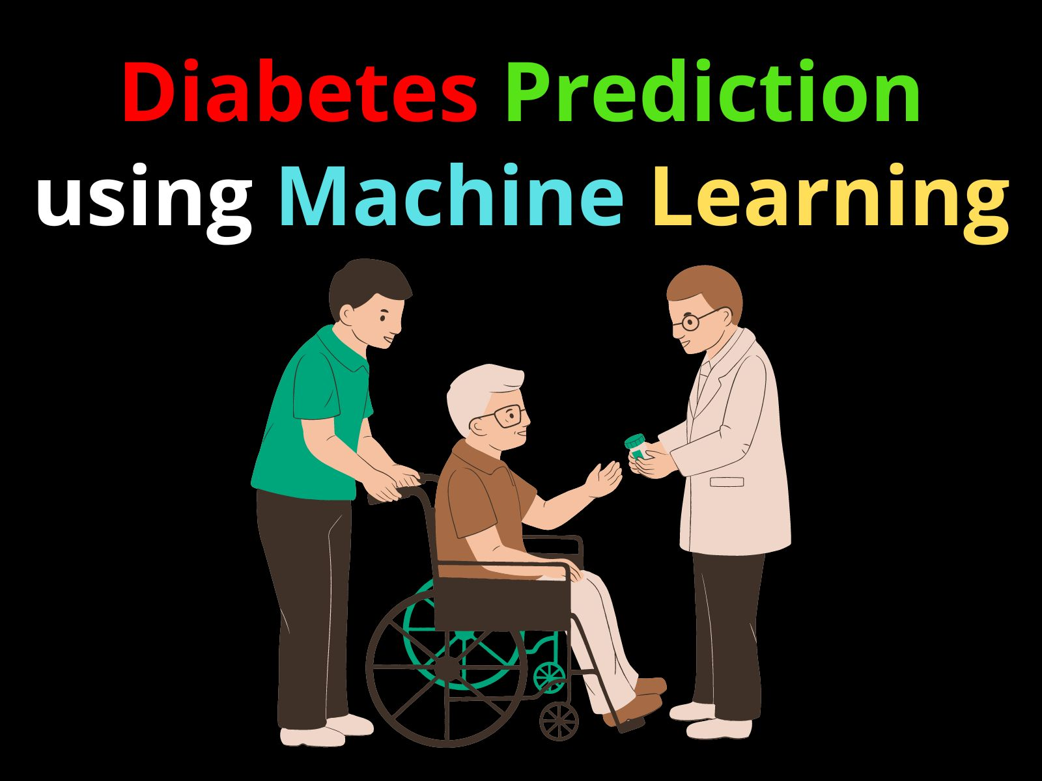

Slide 3
CONTENTS
•ABSTRACT
•INTRODUCTION
•SYSTEM ANALYSIS:
• EXISTING SYSTEM
• PROPOSED SYSTEM
•SYSTEM REQUIREMENTS:
• HARDWARE REQUIREMENTS
• SOFTWARE REQUIREMENTS
•UML DIAGRAMS:
SAMPLE CODE:
OUTPUT SCREENSHORTS
• CONCLUSION
• REFERENCES

Slide 4
ABSTRACT
Diabetes Mellitus is among critical diseases and lots of people are suffering from this disease. Age, obesity, lack of exercise, hereditary diabetes, living style, bad diet, high blood pressure, etc. can cause Diabetes Mellitus.
Diabetes prediction model for better classification of diabetes which includes few external factors responsible for diabetes along with regular factors like Glucose, BMI, Age, Insulin, etc.
Classification accuracy is boosted with new dataset compared to existing dataset.
Further with imposed a pipeline model for diabetes prediction intended towards improving the accuracy of classification.

Slide 5
INTRODUCTION
Diabetic Mellitus (DM) is classified as Non-Communicable Disease (NCB) and many people are suffering from it. Around 425 million people suffer from diabetes according to 2017 statistics.
Diabetes Mellitus (DM) is classified asType-1 known as Insulin-Dependent Diabetes Mellitus (IDDM).
Inability of human’s body to generate sufficient insulin is the reason behind this type of DM and hence it is required to inject insulin to a patient. Type-2 also known as Non-Insulin-Dependent Diabetes Mellitus (NIDDM).
By applying predictive analysis on healthcare data, significant decisions can be taken and predictions can be made.
Machine learning is considered to be a dire need of today’s situation in order to eliminate human efforts by supporting automation with minimum flaws.
This System focuses on building predictive model using machine learning algorithms and data mining techniques for diabetes prediction.

Slide 6
SYSTEM ANALYSIS: • EXISTING SYSTEM
In existing method, the classification and prediction accuracy is not so high. Healthcare industries have large volume databases.
Using big data analytics one can study huge datasets and find hidden information, hidden patterns to discover knowledge from the data and predict outcomes accordingly.
Machine learning and cloud computing will play a major role in the research related work to detect and timely cure it for the people.
Diabetes can cause other variety of health problems like heart attack, kidney failure, high blood pressure and diabetic foot syndrome.

Slide 7
PROPOSED SYSTEM
Diabetes can be controlled if it is predicted earlier. To achieve this goal this project work we will do early prediction of Diabetes in a human body or a patient for a higher accuracy through applying, Various Machine Learning Techniques.
we can use Machine Learning Classification and ensemble techniques on a dataset to predict diabetes. Which are K-Nearest Neighbour (KNN), Logistic Regression (LR), Decision Tree (DT), Support Vector Machine (SVM), Gradient Boosting (GB) and Random Forest (RF).
Machine learning techniques Provide better result for prediction by con- structing models from datasets collected from patients.
The System gives the accurate or higher accuracy model shows that the model is capa- ble of predicting diabetes effectively.

Slide 8
SYSTEM REQUIREMENTS:
5.1 HARDWARE REQUIREMENTS:
• | System | : | Pentium Dual Core.
• | Hard Disk | : | 320 GB.
• | Monitor | : | 15’’ LED
• | Input Devices | : | Keyboard, Mouse
• | Ram | : | 8 GB
SOFTWARE REQUIREMENTS
• | Operating system | : | Windows 10
• | Coding Language | : | python
• | Tool | : | PyCharm
• | Database | : | MYSQL
• | Server | : | Flask

Slide 9
UML DIAGRAMS CLASS DIAGRAM:

Slide 10
USECASE DIAGRAM

Slide 11
SEQUENCE DIAGRAM

Slide 12
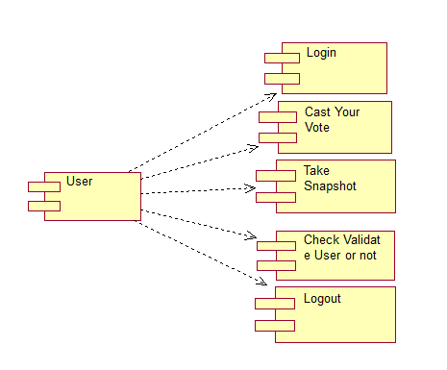
COLLABORATION DIAGRAM

Slide 13
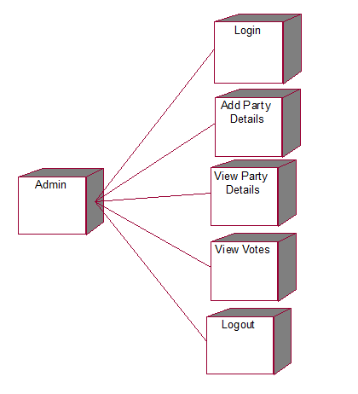
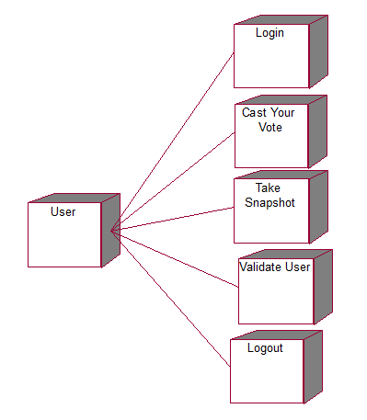
DEPLOYMENT DIAGRAM
Deployment diagram for admin: Deployment diagram for user:

Slide 14
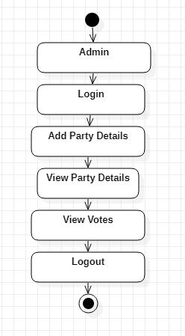
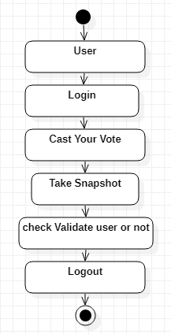
ACITIVITY DIAGRAM
Activity diagram for admin: Activity diagram for user:

Slide 15
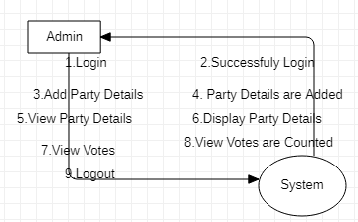
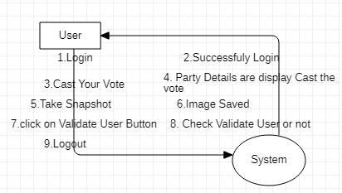
DATAFLOW DIAGRAM
Dataflow diagram for admin: Dataflow diagram for user:

Slide 16
SAMPLE CODE
# Importing essential libraries
from flask import Flask, render_template, request
import pickle
import pandas as pd
import numpy as np
from sklearn import preprocessing
from sklearn.model_selection import train_test_split from sklearn. Ensemble
importRandomForestClassifier
Load the Random Forest CLassifier model filename = 'diabetes-prediction-rfc-model.pkl' classifier = pickle.load(open(filename, 'rb’))
import pandas as pd import numpy as np
from sklearn import preprocessing

Slide 17
from sklearn.model_selection import train_test_split
fromsklearn.ensembleimport
RandomForestClassifier
# Load the dataset
data = pd.read_csv('diabetes_data.csv')
# Select the columns for training
cols = [col for col in data.columns if col not in ['Outcome']]
data = data[cols]
Create the feature array X = data.values
Create the target array
y = diabetes_data.Outcome
Normalize the feature array X = preprocessing.scale(X)

Slide 18
Split the data into training and testing sets
X_train, X_test, y_train, y_test = train_test_split(X, y, test_size=0.2)
@app.route('/')
def home():
return render_template('index.html')
@app.route('/predict', methods=['POST'])
def predict():
if request.method == 'POST':
preg = int(request.form['pregnancies'])
glucose = int(request.form['glucose'])
bp = int(request.form['bloodpressure'])
st = int(request.form['skinthickness'])
insulin = int(request.form['insulin'])
bmi = float(request.form['bmi'])
dpf = float(request.form['dpf'])

Slide 19
age = int(request.form['age'])
data = np.array([[preg, glucose, bp, st, insulin, bmi, dpf, age]))
my_prediction = classifier.predict(data)
return render_template('result.html', prediction=my_prediction)
if __name__ == '__main__':
app.run(debug=True)

Slide 20
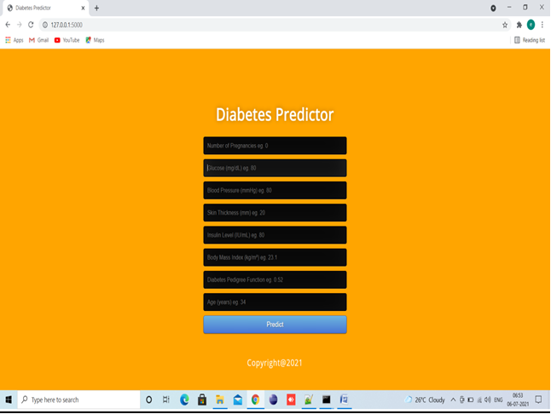
OUTPUT SCREENSHOTS

Slide 21
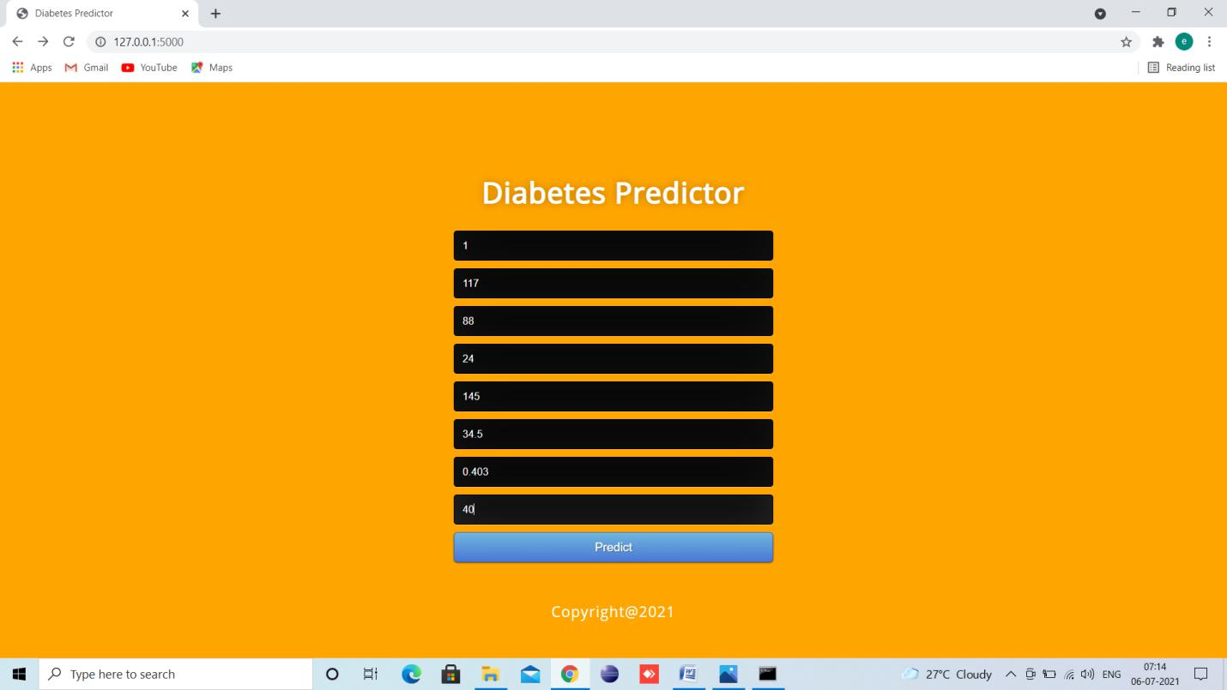

Slide 22
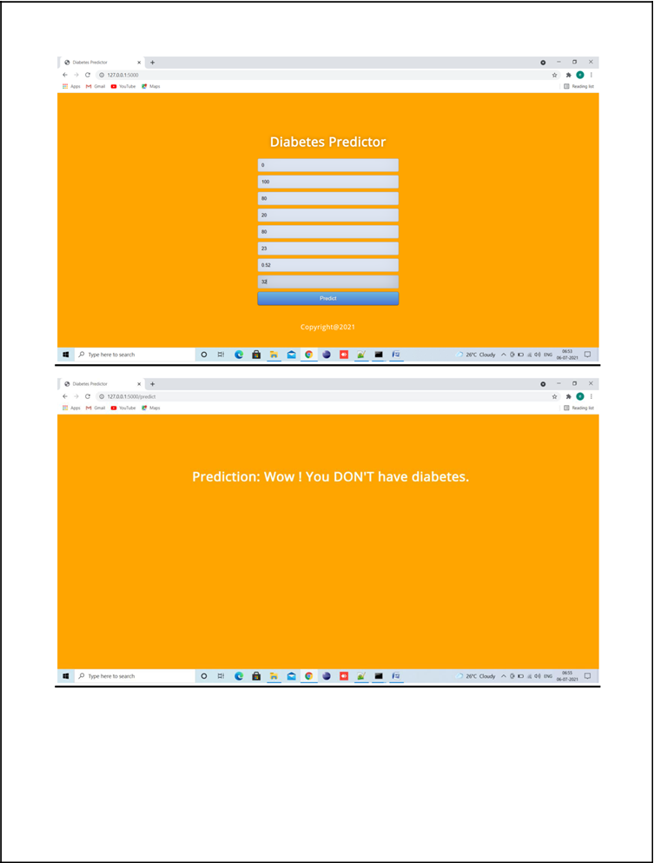

Slide 23
Advantages
cost: this technique requires no cost compared to hospitalization as users will be having wearable device which will read his condition and inform to patients and hospitals using his smart phone
Comfortable: as these wearable devices are small and patients can wear it and keep working on his daily activities.
Sustainability: Devices can be in contact with hospital servers which will have complex data mining algorithms running on it. After receiving patient data server will run those algorithms to predict patient condition and send report back to devices.
Personalization: In this technique one patient can share his data with other patient based on distance between cloud servers they are using to store data. Here we are using dataset so sharing is not possible but i am making all predicted test data values to be open so all users can see or share it.

Slide 24
Disadvantages
Cannot predict the accurate results in terms of diabetes classification.
Higher costs for the tests and all other things.
May not have Personalization, Sustainability.
Most of them are not comfortable to the patients.
Early detection of diabetes is not possible.

Slide 25
CONCLUSION
In this study, various machine learning algorithms are applied on the dataset and the classification has been done using various algorithms of which Logistic Regression gives highest accuracy of 96%. Application of pipeline gave AdaBoost classifier as best model with accuracy of 98.8%. We have seen comparison of machine learning algorithm accuracies with two different datasets. It is clear that the model improves accuracy and precision of diabetes prediction with this dataset compared to existing dataset. Further this work can be extended to find how likely nondiabetic people can have diabetes in next few years.

Slide 26
REFERENCES
[1] S. Mendis, “Global Status Report on Noncommunicable Diseases 2014,” WHO, tech. rep.; http://www.who.int/ nmh/publications/ncd-status-report-2014/en/, accessed Jan. 2015.
[2] F. Florencia et al.,IDF Diabetes Atlas, 6th ed., Int’l. Diabetes Federation, tech. rep.; http://www.diabetesatlas.org/, accessed Jan. 2016.
[3] M. Chen et al., “Disease Prediction by Machine Learning over Big Healthcare Data,” IEEE Access, vol. 5, June 2017, pp. 8869—79
[4] O. Geman, I. Chiuchisan, and R. Toderean, “Application of Adaptive Neuro-Fuzzy Inference System for Diabetes Classification and prediction},” Proc. 6th IEEE Int’l. Conf. E-Health and Bioengineering, Sinaia, Romania, July 2017, pp. 639--642.
[5] S. Fong, et al. “Real-Time Decision Rules for Diabetes Therapy Management by Data Stream Mining,” IT Professional, vol. 26, no. 99, June 2017, pp. 1--8.
[6] B. Lee, J. Kim, “Identification of Type 2 Diabetes Risk Factors Using Phenotypes Consisting of Anthropometry and Triglycerides Based on Machine Learning,” IEEE J. Biomed. Health Info., vol. 20, no. 1, Jan. 2016, pp. 39--46.

